Slide 1
Optical character recognition (OCR) in R

Slide 2
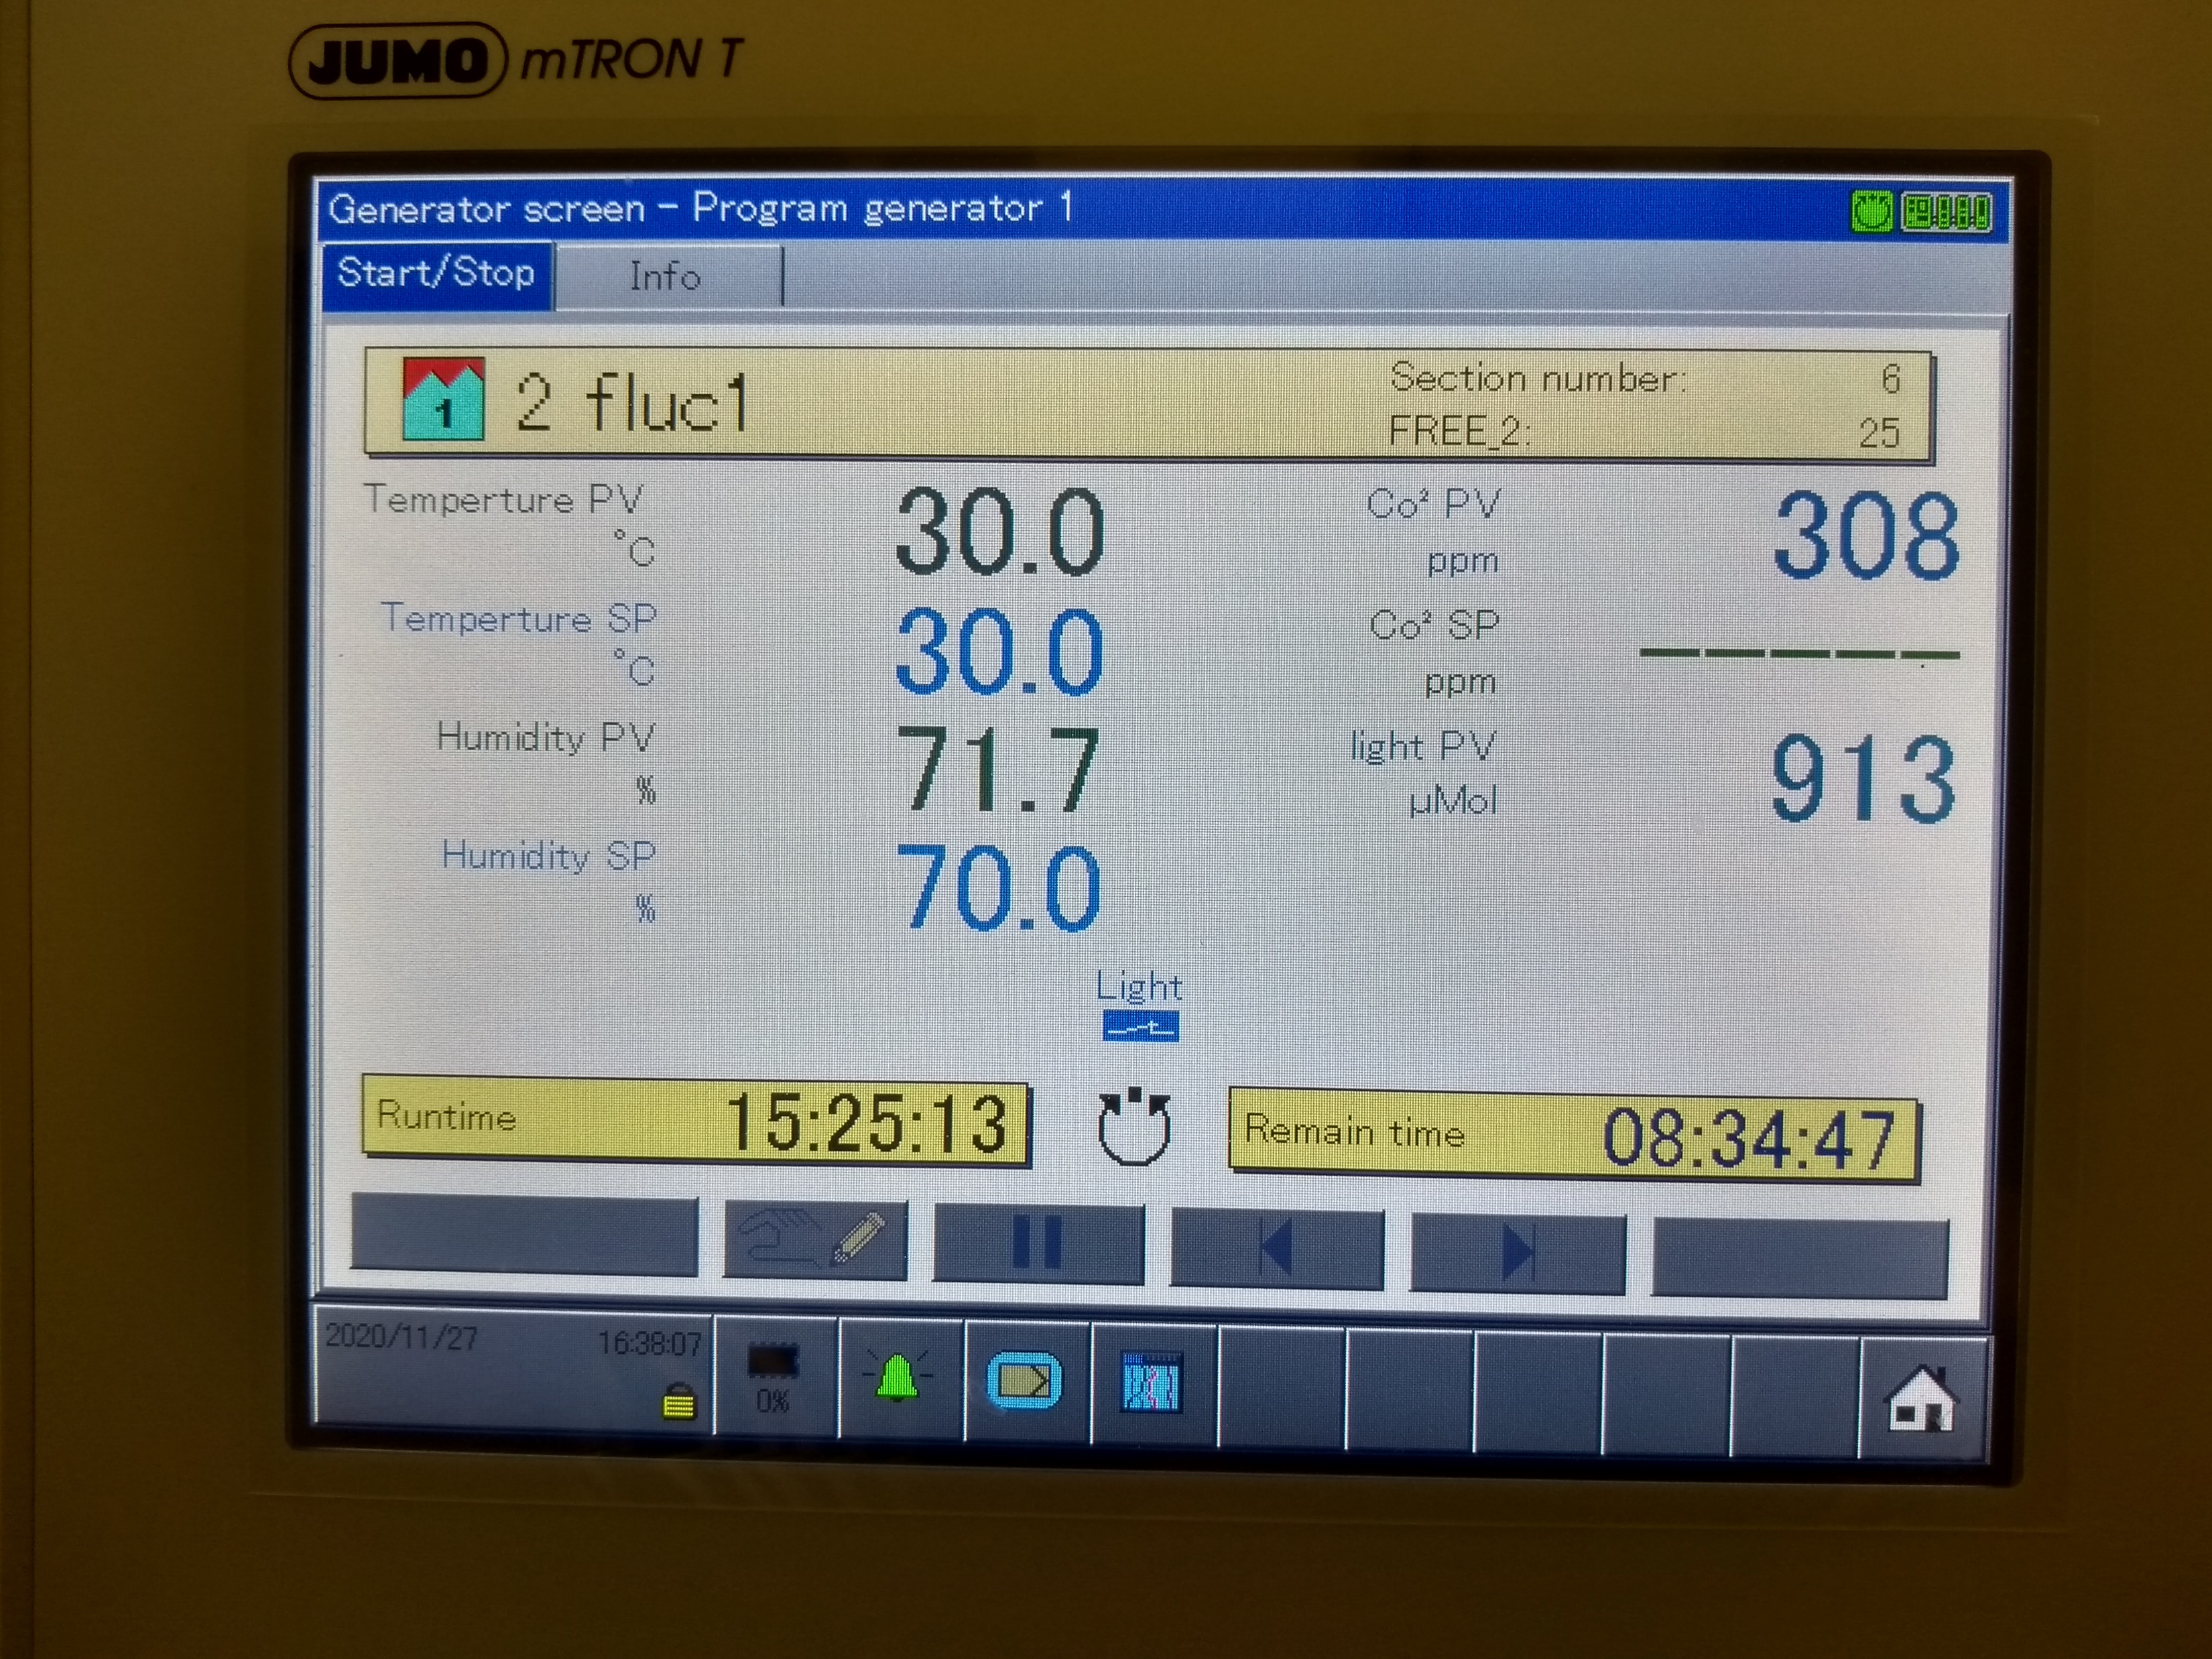
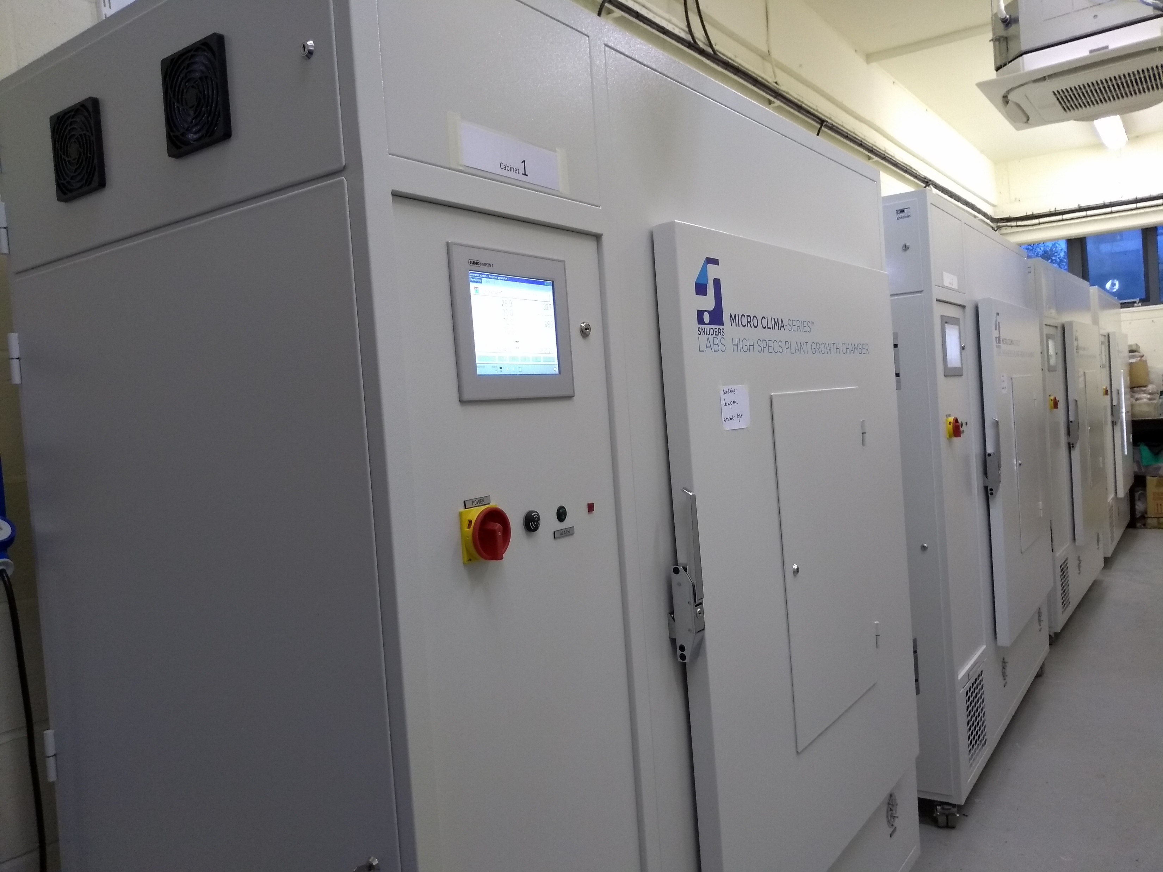
The problem
Controlled environment plant growth cabinets
Constantly measuring conditions but not recording!
Data could be extracted from timelapse camera recording cabinet screen?

Slide 3
Time-lapse camera
Timelapse camera recording screen of cabinet
Image every 5min
Produces a video from images

Slide 4
Steps
Split video into images
Crop each image to find individual values
Extract text
TempPV | TempSP | HumidPV | HumidSP | CO2PV | CO2SP | LightPV
30.0 | 30.0 | 71.7 | 70.0 | 308 | ----- | 913

